Slide 1

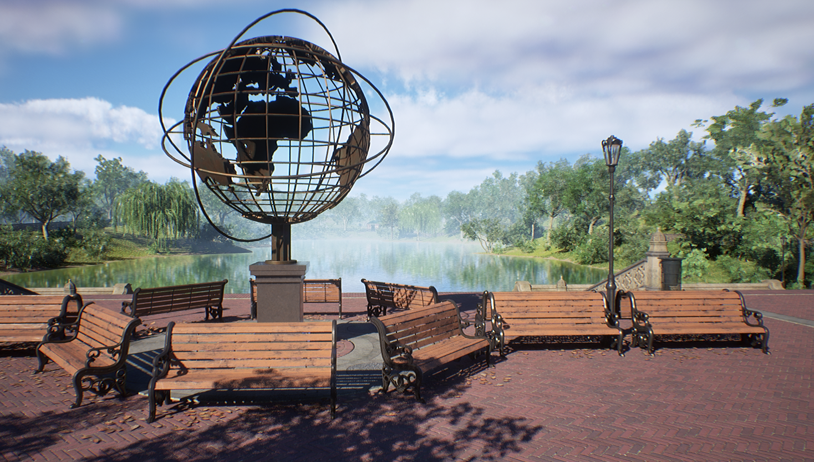








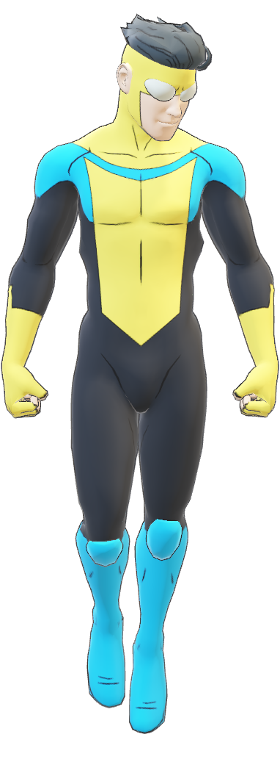
Right
Hero

Slide 2




















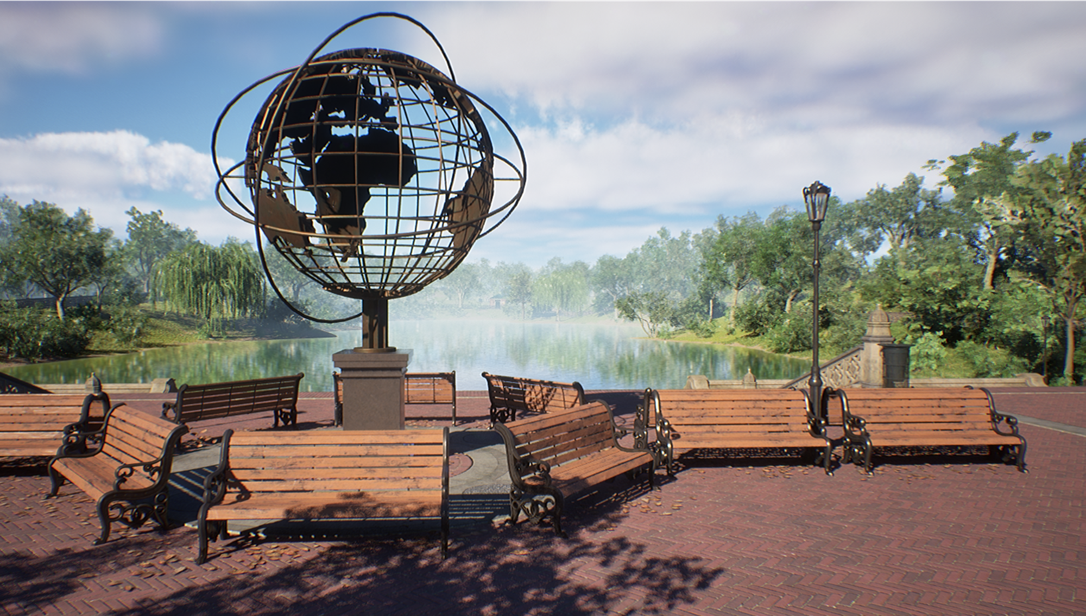
Table of
Contents

Slide 3
Our
Mission
What Makes Right Quest Special?
Right Quest is not just a game—it's an educational adventure.
A fun RPG experience tailored for kids aged 12-15 Teaches real-world values about children's rights
Combines learning with interactive storytelling and gameplay

Slide 4
Our
Mission
What Makes Right Quest Special?
Right Quest is not just a game—it's an educational adventure.
A fun RPG experience tailored for kids aged 12-15 Teaches real-world values about children's rights
Combines learning with interactive storytelling and gameplay

Slide 5
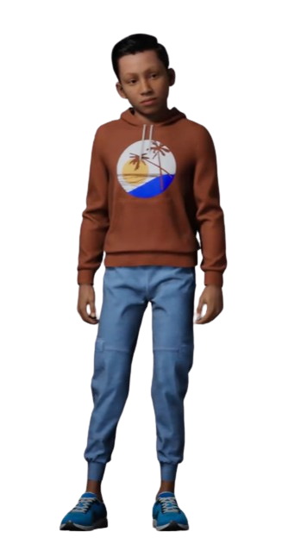

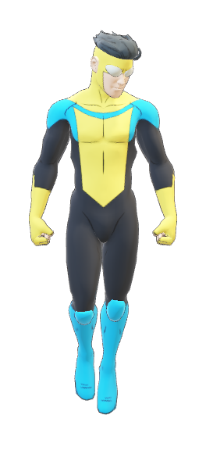
Gameplay
Overview
You play as Aavi, a schoolboy on a mission to become the next Right Hero
Explore the city park, interact with talking animals
Complete quests by answering questions about children's rights
Each correct answer helps Aavi grow into a hero

Slide 6

Gameplay
Overview
You play as Aavi, a schoolboy on a mission to become the next Right Hero
Explore the city park, interact with talking animals
Complete quests by answering questions about children's rights
Each correct answer helps Aavi grow into a hero

Slide 7





03
01
Audio
Game Engine
Audacity & Freesound.org
Unreal Engine
Tech Stack
Tech
Stack
02
3d Models
Blender & Quixel Megascans
04
UI
Unreal Motion Graphics

Slide 8
Tech
Stack
Tech Stack
01
03
Game Engine
Audio
Unreal Engine
Audacity & Freesound.org
02
04
3d Models
UI
Blender & Quixel Megascans
Unreal Motion Graphics

Slide 9


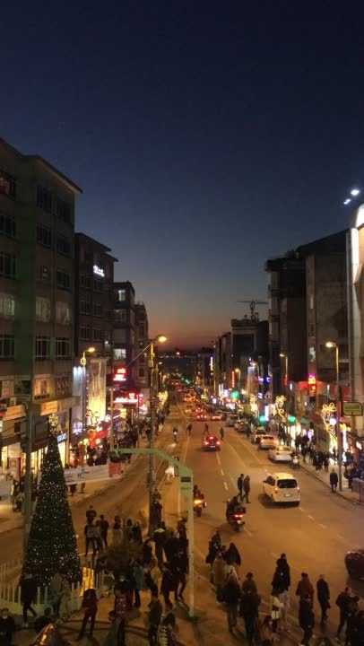

Visual
Style
Vibrant, cartoon-inspired art style
Colorful, welcoming environments designed for kids
Talking animal characters with expressive animations
Friendly atmosphere to foster a safe, engaging experience

Slide 10
Visual
Style
Vibrant, cartoon-inspired art style
Colorful, welcoming environments designed for kids
Talking animal characters with expressive animations
Friendly atmosphere to foster a safe, engaging experience

Slide 11
Story
Line
One day, Aavi walks out of school and visits the city park. There he meets a superhero named Right Hero. The hero challenges him to complete quests to earn the title of the next Right Hero. Each quest involves understanding and defending children's rights.

Slide 12
Story
Line
One day, Aavi walks out of school and visits the city park. There he meets a superhero named Right Hero. The hero challenges him to complete quests to earn the title of the next Right Hero. Each quest involves understanding and defending children's rights.

Slide 13
A
C
What Kids
B
D
Learn
The right to education, safety, expression, and participation
Empathy and respect for others
Critical thinking through question-based quests
Recognition of real-life challenges faced by children

Slide 14
What Kids
Learn
A
C
B
D
The right to education, safety, expression, and participation
Empathy and respect for others
Critical thinking through question-based quests
Recognition of real-life challenges faced by children

Slide 15
A
B
C
D
The right to education, safety, expression, and participation
Empathy and respect for others
Critical thinking through question-based quests
Recognition of real-life challenges faced by children

Slide 16
Challenges
& Solution
Designing age-appropriate yet challenging questions → Collaborated with educators for accuracy and tone
Engaging gameplay for younger audience → Used vibrant visuals and intuitive UI
Simplifying game mechanics → Leveraged Unreal Blueprints for efficient development

Slide 17
Challenges
& Solutions
Designing age-appropriate yet challenging questions → Collaborated with educators for accuracy and tone
Engaging gameplay for younger audience → Used vibrant visuals and intuitive UI
Simplifying game mechanics → Leveraged Unreal Blueprints for efficient development

Slide 18
Meet the
Team

Slide 19



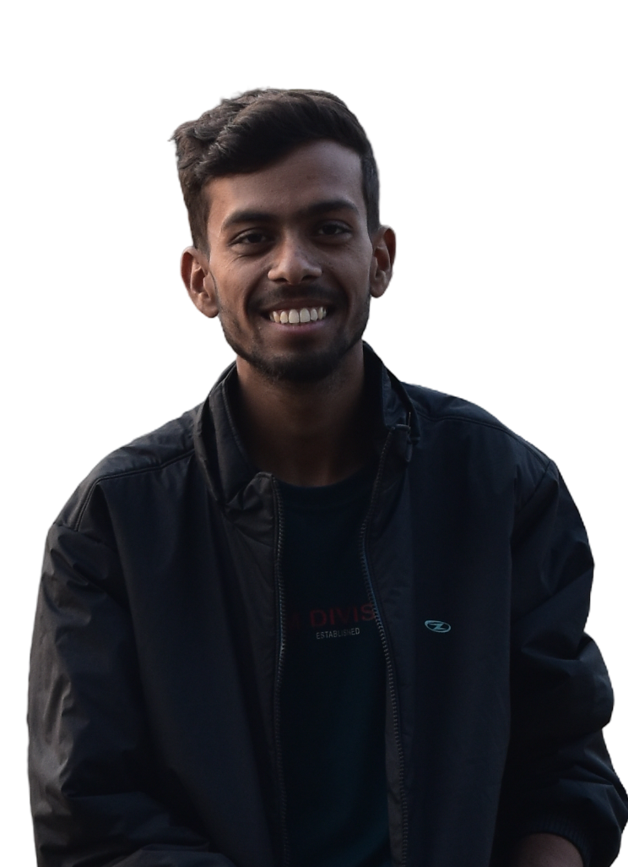
Meet the
Meet the
Team
Team
Our Team that made this Project Possible
Our Team that made this Project Possible
Manik Chand Sahu
Manik Chand Sahu
Ishant Sinha
Ishant Sinha
Harsh Garewal
Harsh Garewal
Shristi Mishra
Shristi Mishra
Developer
& Designer
Developer
& Designer
Game Logic
& Scripting
Game Logic
& Scripting
3D Assets & Animation
3D Assets & Animation
Content & Story Writing
Content & Story Writing

Slide 20
Future
Scale
Support
Mobile
Localize
Roadmap
1
2
3
4
Voice-over support for younger children
Mobile and tablet version
Localization in multiple languages
Expand quests and question bank

Slide 21
Future
Roadmap
Scale
Support
Mobile
Localize
1
2
3
4
Voice-over support for younger children
Mobile and tablet version
Localization in multiple languages
Expand quests and question bank

Slide 22
Thank You!
Ready to make learning fun for kids. Questions? Feedback? Let's talk!

